Slide 1

Chip retail analytics

Slide 2
EXECUTIVE SUMMARY
TO FIND THE TOTAL SALES
TASK 1
TASK 2
TO FIND THE TOTAL NUMBER OF CUSTOMER & TRANSACTIONS

Slide 3
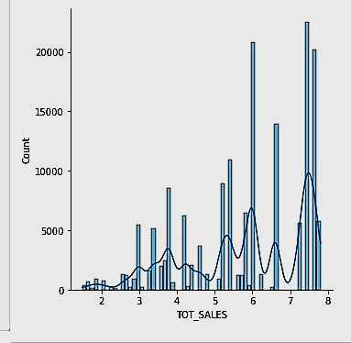
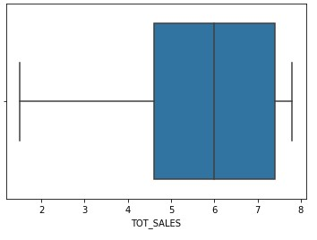
TOTAL SALES
TOTAL_SALES=1933114
ERROR-FREE DATA

Slide 4
CUSTOMERS AND TRANSACTIONS
Total customer's = 241584
AVERAGE TRANSACTIONS PER CUSTOMER = 0.9122091574344684

Slide 5


